Slide 1
Ex7-midterm exam
2023.11.22

Slide 2
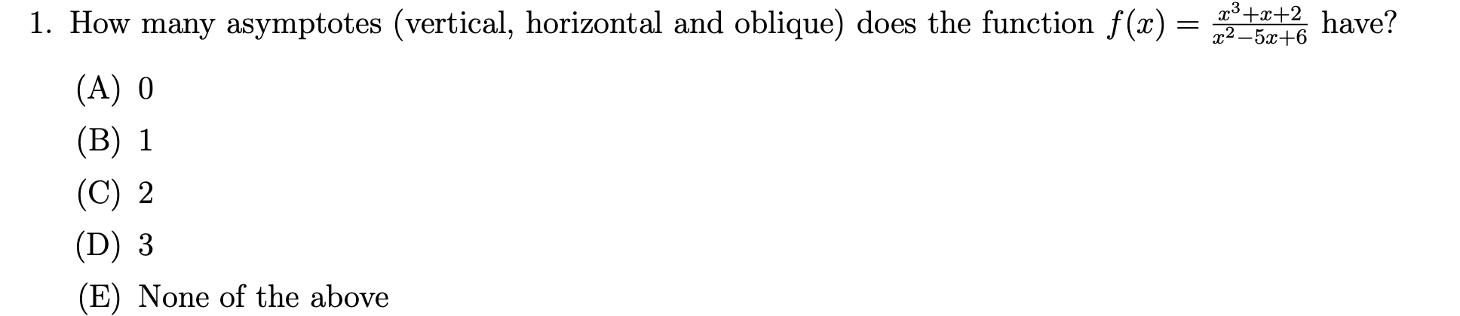
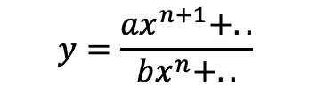

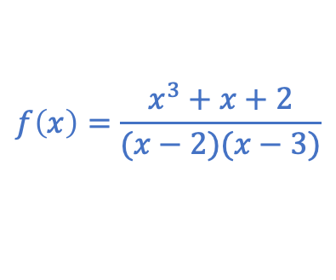









D
$$f\left(x\right)=\frac{x^{3}+x+2}{(x−2)(x−3)}$$
$$\lim_{x→k}f\left(x\right)=±∞$$
Yes
$$x=2;x=3$$
Vertical
Horizonal
Oblique
Is it possible that denominator tends to 0?
$$\lim_{x→±∞}f\left(x\right)=∞$$
$$\lim_{x→±∞}f\left(x\right)−x=\frac{x^{3}+x+2}{x^{2}−5x+6}−x$$
$$\lim_{x→±∞}f\left(x\right)=b$$
No
$$=\frac{5x^{2}+2−7x}{x^{2}−5x+6}$$
Does the limit of fx as x approach $∞$ exist?
$$=\frac{x^{3}+x+2−(x^{3}−5x^{2}+6x)}{x^{2}−5x+6}$$
$$y=\frac{{ax}^{n+1}+..}{{bx}^{n}+..}$$
Yes
$$=\frac{\left(5x^{2}−25x+30\right)−28+18x}{x^{2}−5x+6}$$
Is the degree of the numerator of a rational function one greater than the degree of the denominator
$$=5+\frac{18x−28}{x^{2}−5x+6}$$
$$=5$$
y=x+5

Slide 3
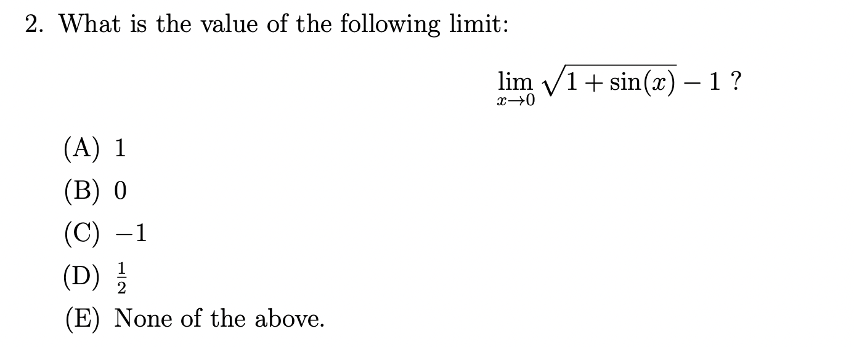
B
$$\sqrt{1+sin0}−1=0$$

Slide 4
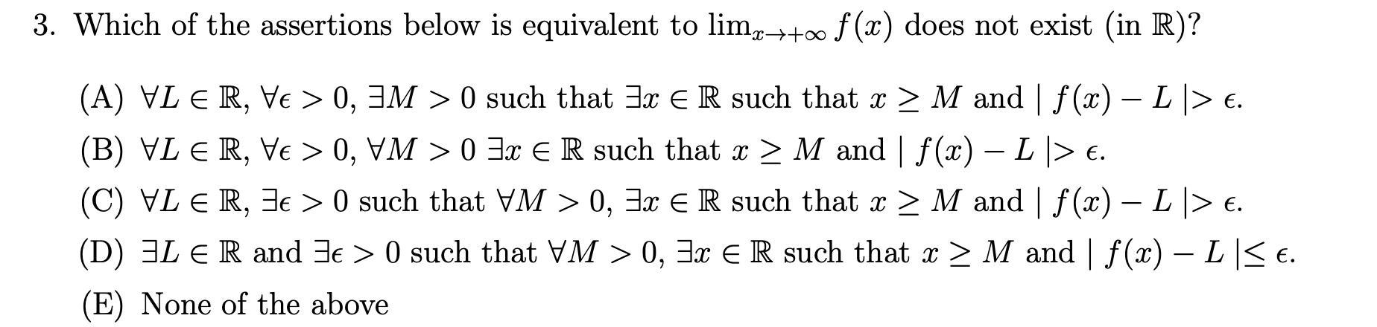
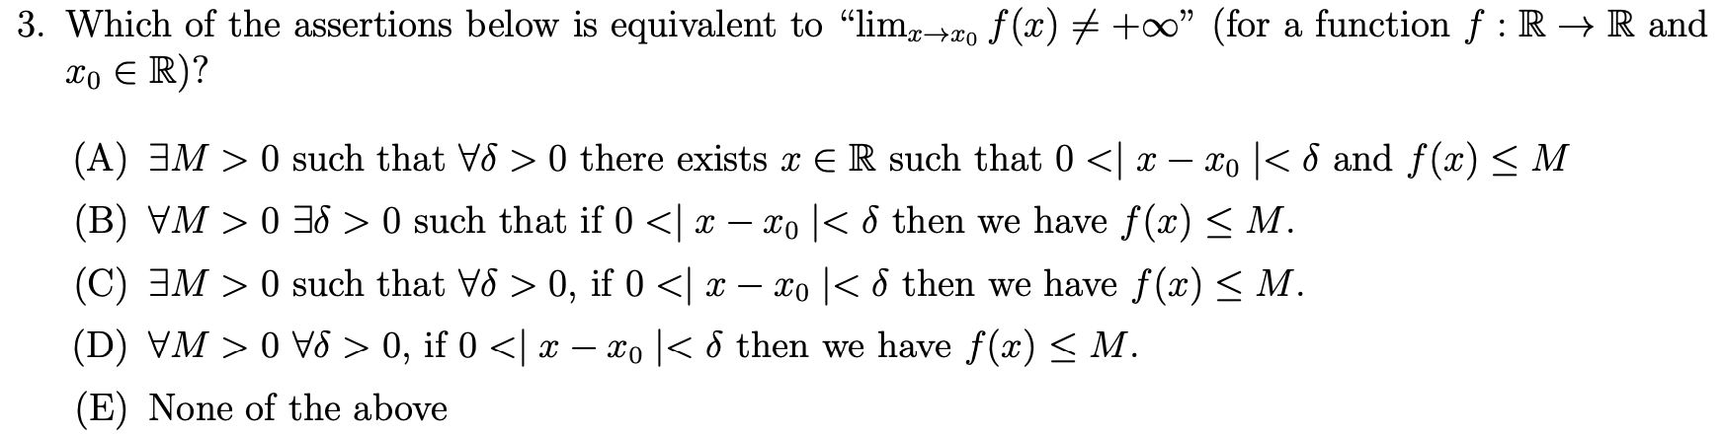
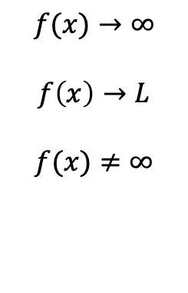
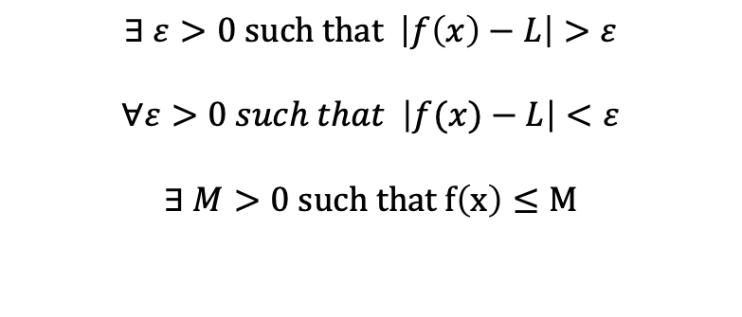
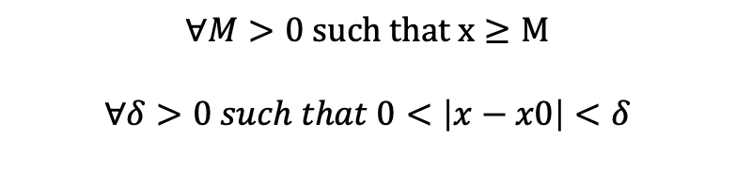
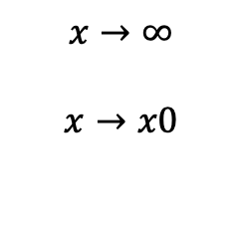
(mid)
C
(exercise)
$$x→∞$$
$$x→x0$$
$$∀M>0 such that x≥M$$
$$∀δ>0 such that 0<\left|x−x0\right|<δ$$
$$f(x)→∞$$
$$f\left(x\right)→L$$
$$f(x)≠∞$$
$$∃ ε>0 such that \left|f\left(x\right)−L\right|>ε$$
$$∀ε>0 such that \left|f(x)−L\right|<ε$$
$$∃ M>0 such that f\left(x\right)≤M$$

Slide 5
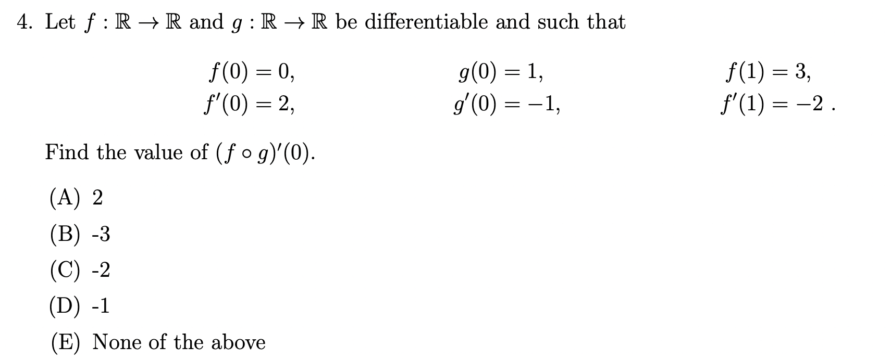
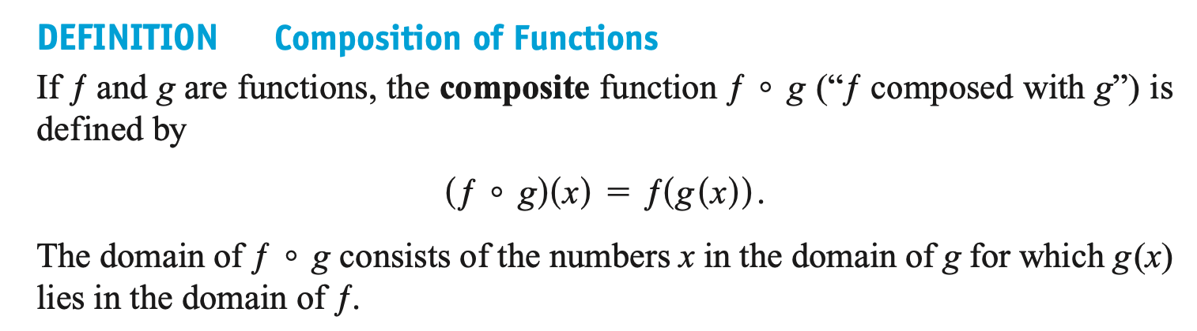
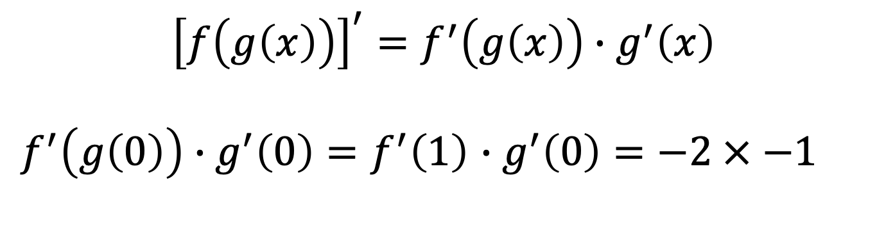
A
$${\left[f\left(g\left(x\right)\right)\right]}^{′}=f^{′}\left(g\left(x\right)\right)∙g^{′}\left(x\right)$$
$f^{′}\left(g\left(0\right)\right)∙g^{′}\left(0\right)=f^{′}\left(1\right)$ $∙g^{′}\left(0\right)=−2 × −1$

Slide 6
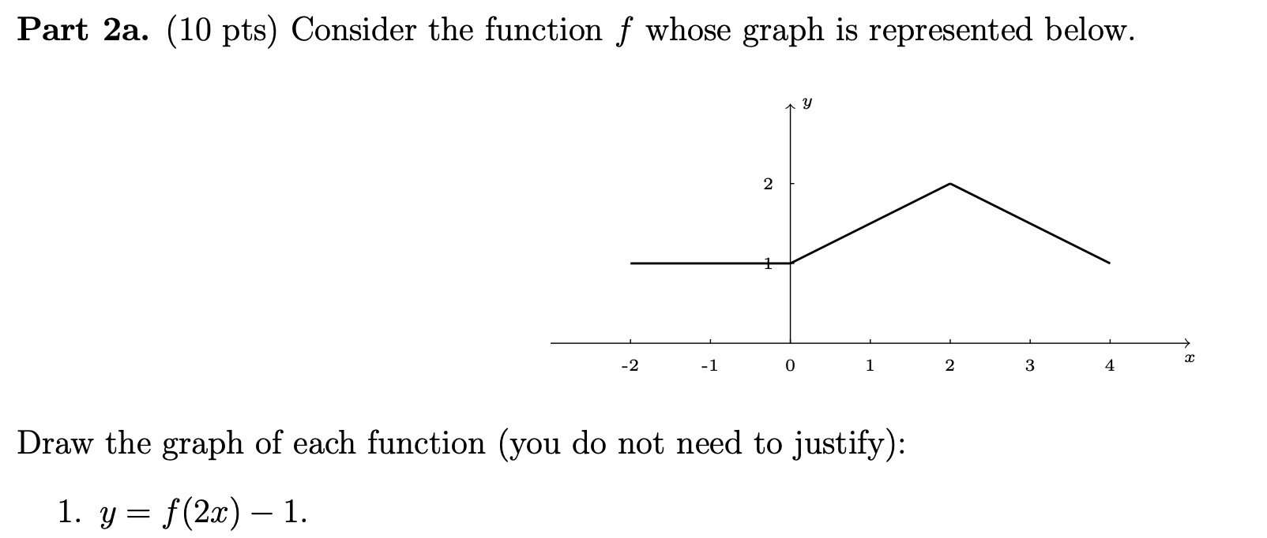
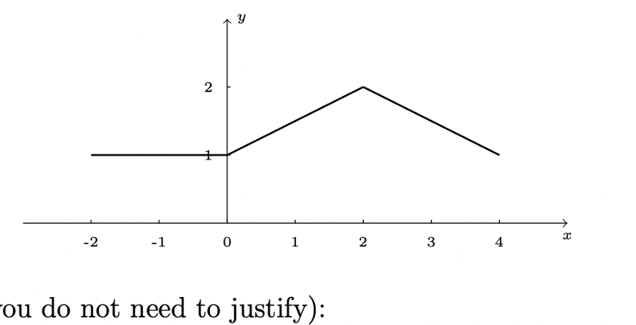
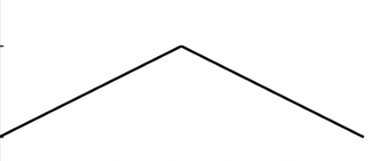

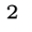
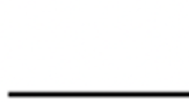
2 points for coordinates/axis
=f(2(x+1))
Compress horizontally by 2
Compress horizontally by 2
Shift down 1
Shift left 1

Slide 7
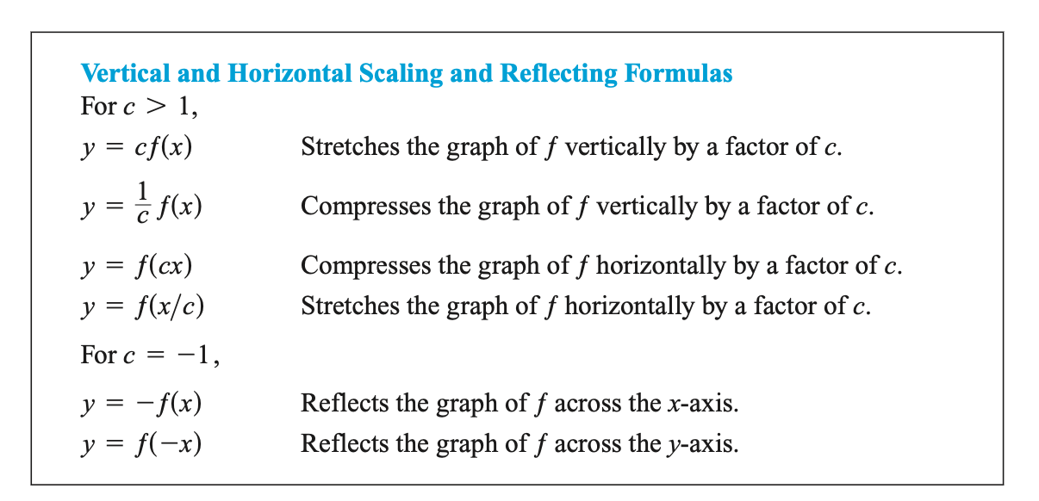
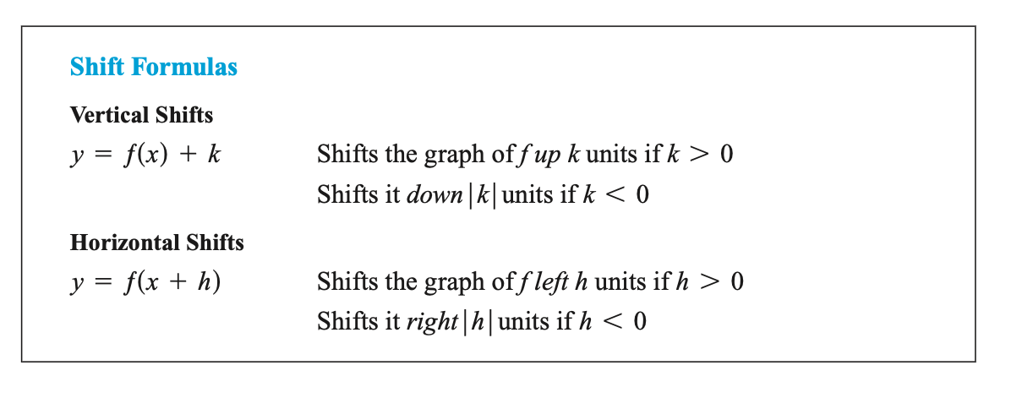

Slide 8
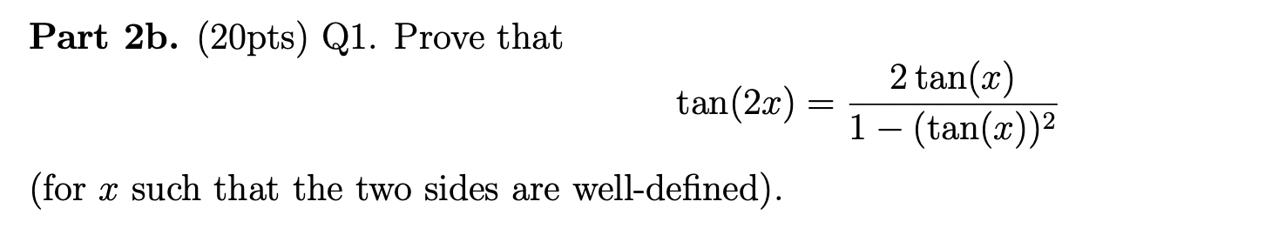
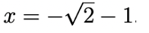
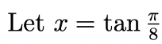
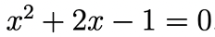
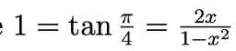
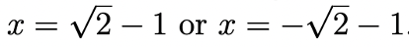
Solution1: since $\tan\left(α+β\right)=\frac{\tan{α+\tan{β}}}{1−\tan{α tanβ}}$, so ….
Divided cos²x
Solution2: $\tan\left(2x\right)=\frac{sin({2x{)}}}{cos({2x)}}=\frac{2sin{x{cos⁡x}}}{\cos^{2}x−\sin^{2}x}=\frac{2tanx}{1−\tan^{2}x}$
Divided cos²x
-2 points if you do not exclude

Slide 9
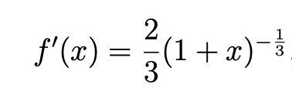
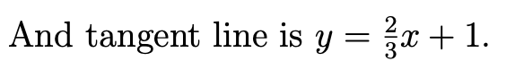
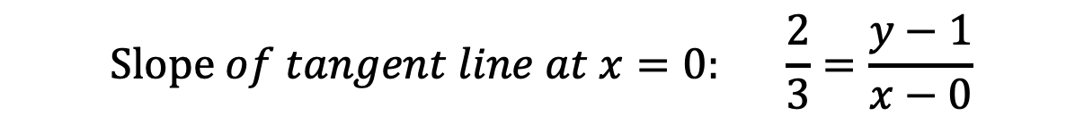
Find the derivative of function
Replace x of given point in the derivative.-> get the slope of tangent at x
Use slope and given point to get the equation of tangent.
$$Slope of tangent line at x=0: \frac{2}{3}=\frac{y−1}{x−0}$$

Slide 10
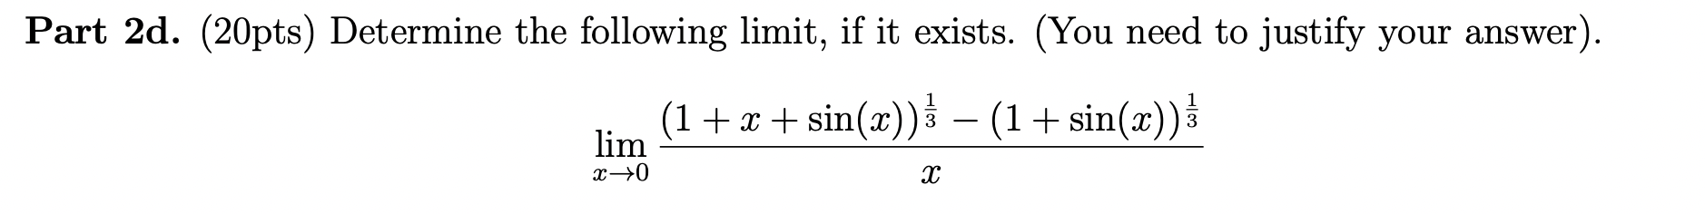
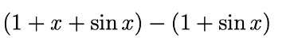
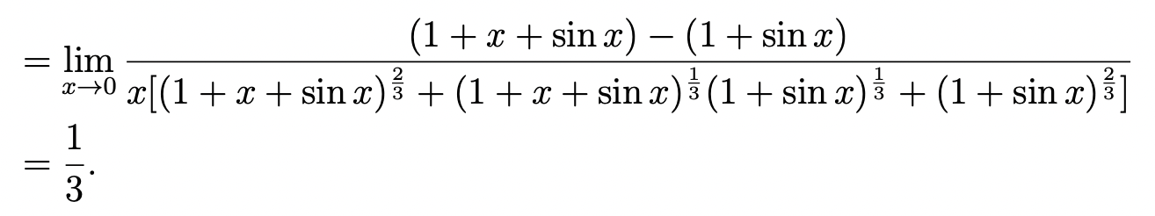


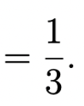
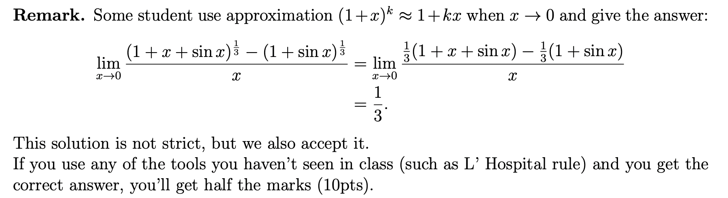
a
b
Vertical variance formula
a³-b³=(a-b)(a²+ab+b²)
[
]

Slide 11
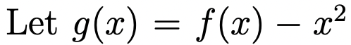
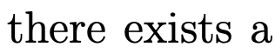

Slide 12
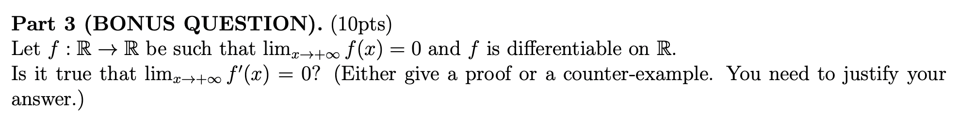
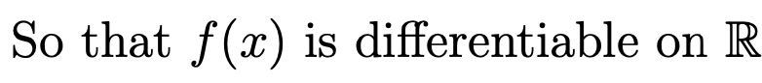
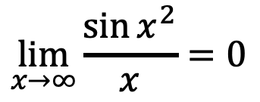
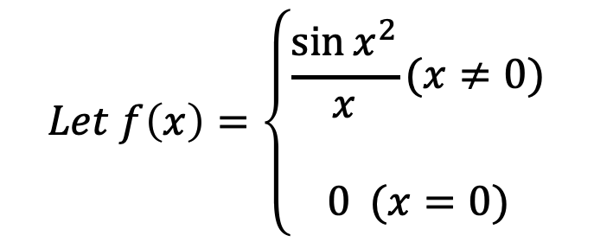
$$Let f\left(x\right)=\left\{\begin{aligned}\frac{\sin{x^{2}}}{x}(x≠0) \\ \\ 0 (x=0)\end{aligned}\right.$$
$$\lim_{x→∞}{\frac{\sin{x^{2}}}{x}=0}$$
$$\lim_{x→0+}{\frac{\sin{x^{2}}}{x}=\lim_{x→0+}{\frac{\sin{x^{2}}}{x^{2}}∙\frac{x^{2}}{x}=(\lim_{x^{2}→0}{\frac{\sin{x^{2}}}{x^{2}})∙\lim_{x→0+}\frac{x^{2}}{x}=}} 1 ×0=0}$$
$$\lim_{x→0−}{\frac{\sin{x^{2}}}{x}=\lim_{x→0−}{\frac{\sin{x^{2}}}{x^{2}}∙\frac{x^{2}}{x}=(\lim_{x^{2}→0}{\frac{\sin{x^{2}}}{x^{2}})∙\lim_{x→0−}\frac{x^{2}}{x}=}} 1 ×0=0}$$

